Slide 1


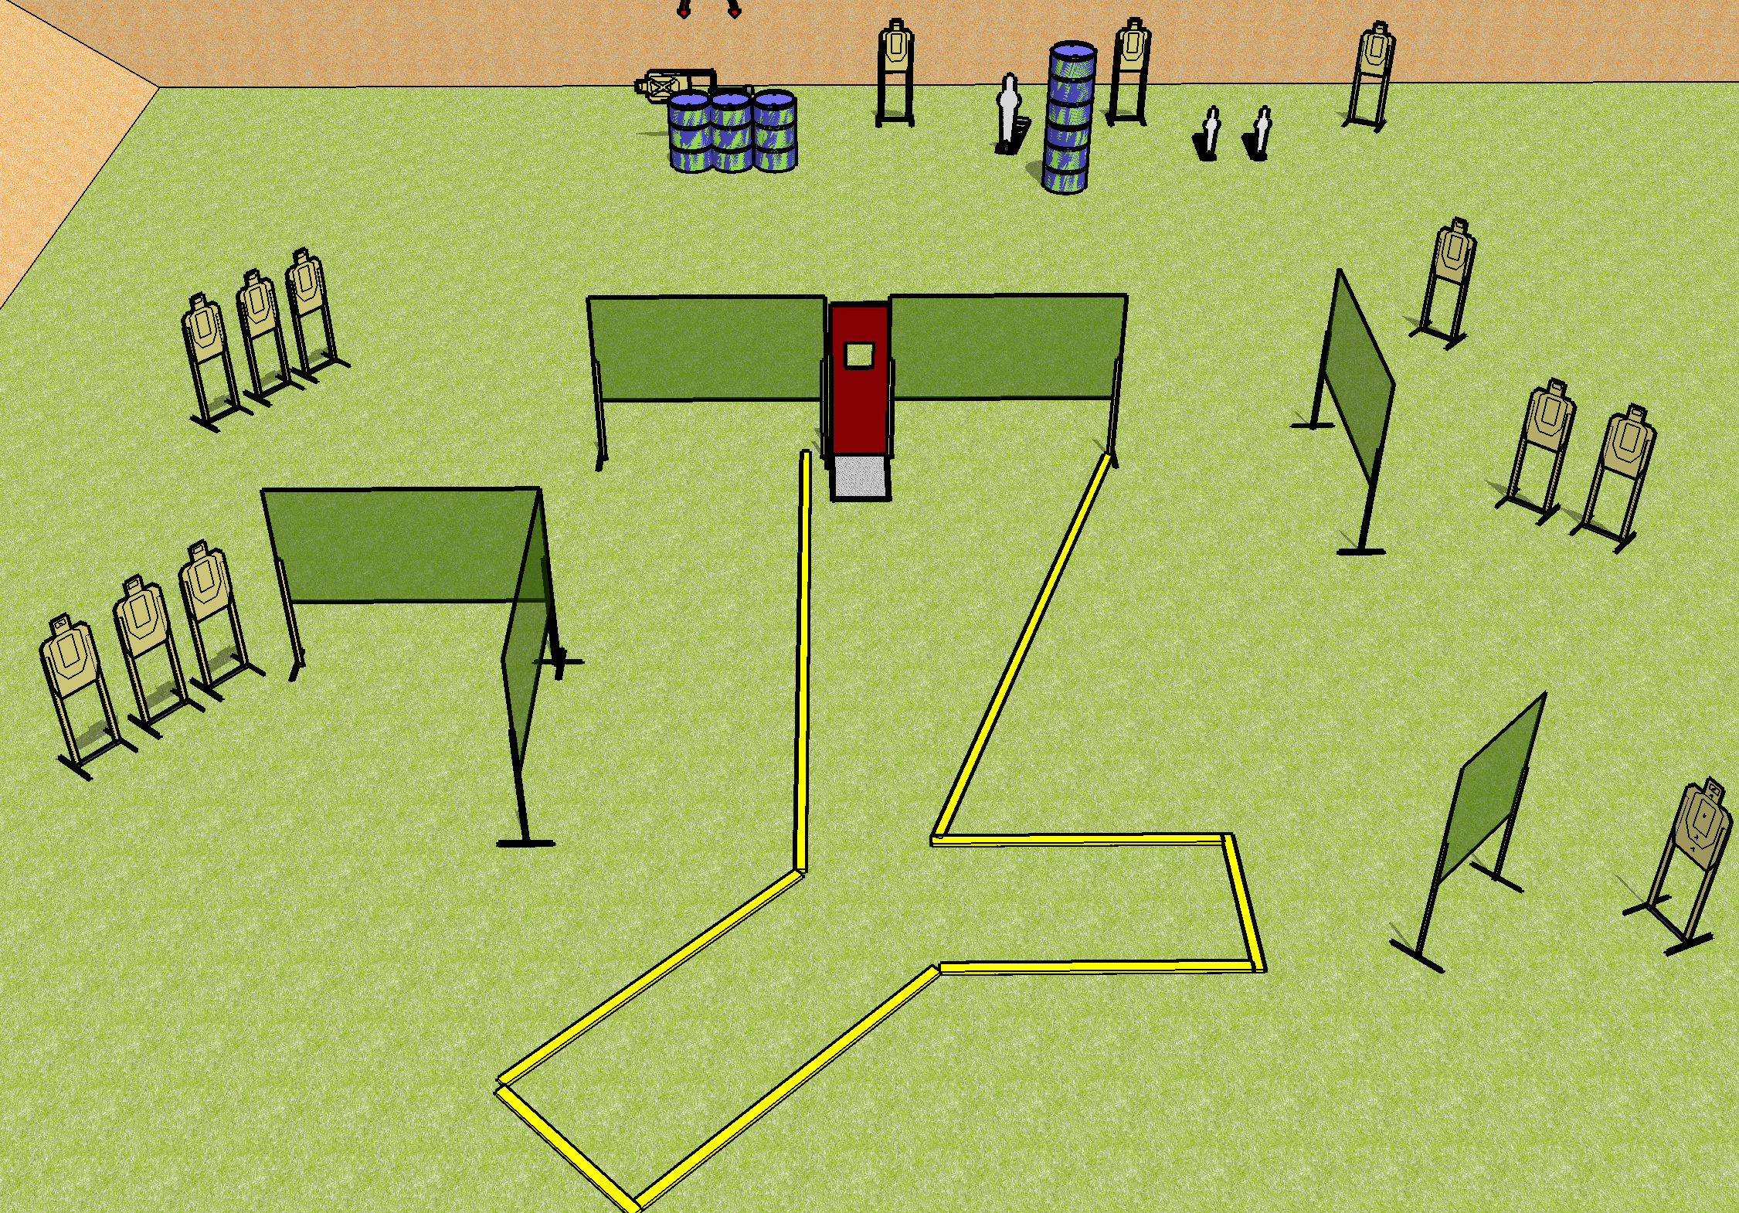
 | Dothan Gun Club – USPSA Match Nightmare Fuel Course Designer : Drew Coleman
Round Count 31 rounds 14 USPSA 1 PP, 2 MP
Equipment List 11 wall feet 2 medium fault lines Pull cord prop 14 targets Swinger + Activator

Slide 2
Nightmare Fuel
Written Stage Briefing
Nightmare Fuel is a 31 round, 155-point, Comstock course of fire. There are 14 USPSA targets and 3 steel. The best 2 hits on cardboard will score and steel must fall to score.
The swinger is activated by the pepper popper and remains visible at rest.
Handgun start position is anywhere inside the shooting area, wrists below belt. Handgun is loaded and holstered.
PCC start position is anywhere inside the shooting area, stock on belt. Loaded carbine is held with both hands, safety on.
On the audible start signal, engage targets as they become available from within the shooting area.

